Slide 1
Capstone Project: Battle of Neighboorhoods Presentation

Slide 2
Projektanalyse – Folie 2
Contents
CONCLUSION
BUSINESS PROBLEM
PROJEKT
DISCUSSION
DATA
RESULTS
METHODOLOGY

Slide 3

Projektanalyse – Folie 3
Business Problem
Target of this project is finding the most promising neighborhoods in Munich, Germany for opening new fitness centers.
Stakeholders are fitness trainers who want to start their own business or big fitness companies who want to expand their business within Munich.
MARKTANALYSE
TECHNISCHE ANALYSE

Slide 4
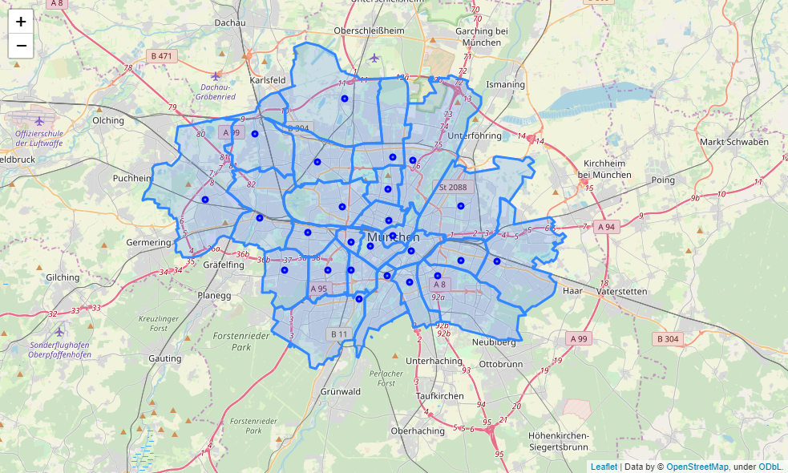
Projektanalyse – Folie 3
Data
Geographical Data
Munich is divided into 25 Neighborhoods. Total population is 1.54 Mio. (3rd largest city in Germany)
Source of the geojson-file is: https://gist.github.com/webtobesocial

Slide 5
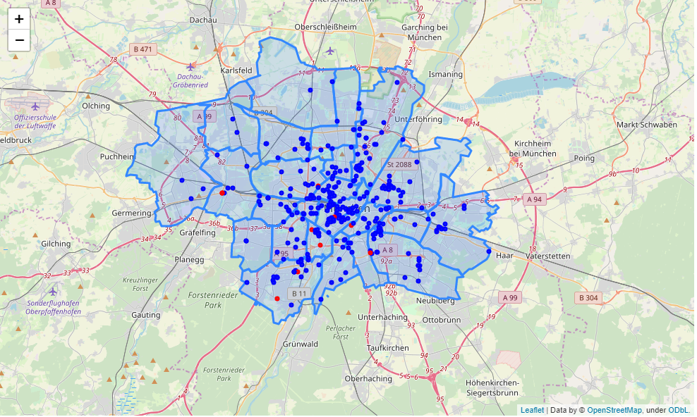

Projektanalyse – Folie 3
Data
Fitness Center Data
The fitness center location data in Munich is taken from FOURSQUARE venue search
Search category is “Fitness Center”
Datasource: https://foursquare.com/city-guide

Slide 6
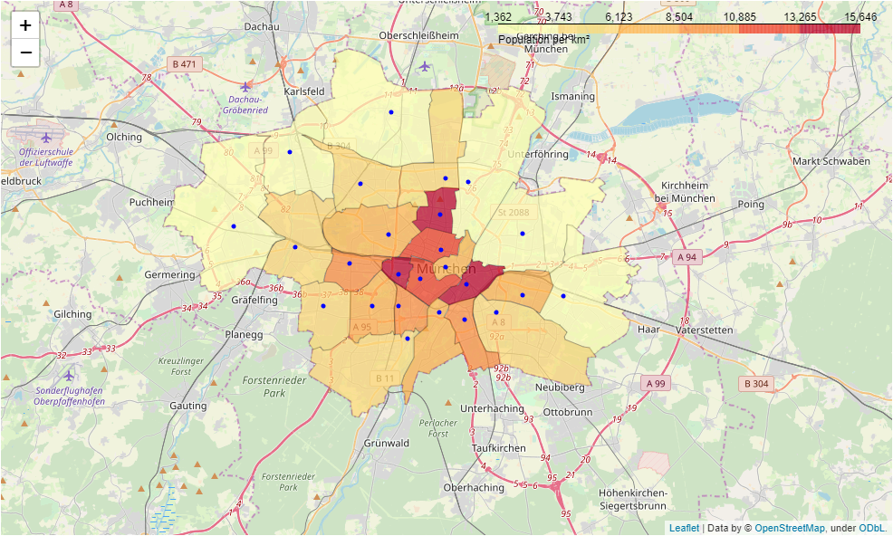
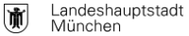
Projektanalyse – Folie 3
Data
Population Data Munich
For clustering of the Neighborhoods 10 public datasets are used:
Population Density
Average Age
Single-Person Households
Women percentage
Birthrate
Aging Index
Youth Index
Unemployment rate
Welfare recipients rate
Migration background percentage
Example: Population Density
Datasource: https://www.opengov-muenchen.de/

Slide 7
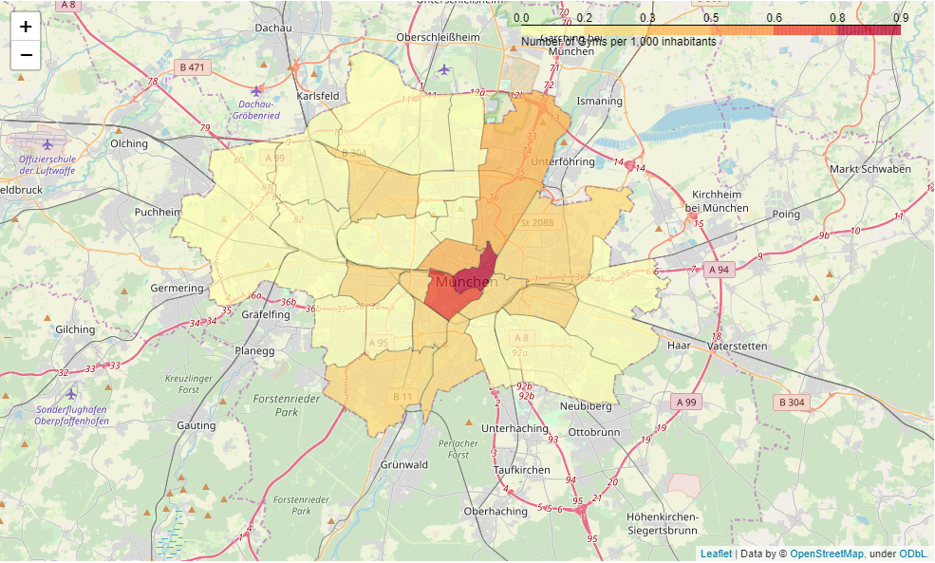
Projektanalyse – Folie 3
Methodology
Fitness Center Key figures
Based on the fitness center location data from FOURSQUARE and the Population data 3 key figures for each Neighborhood are calculated:
Gym count
Gyms per 1,000 inhabitants
Gyms per Area km²
Gym Density per 1,000 inhabitants

Slide 8
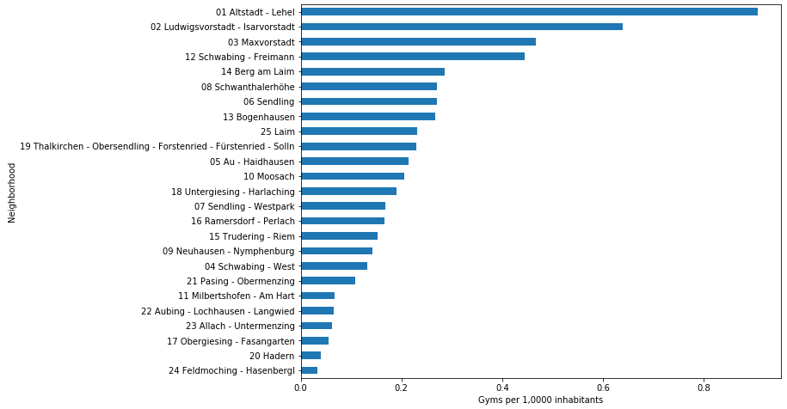
Projektanalyse – Folie 3
Methodology
Fitness Center Key figures
Gym Density per km²

Slide 9
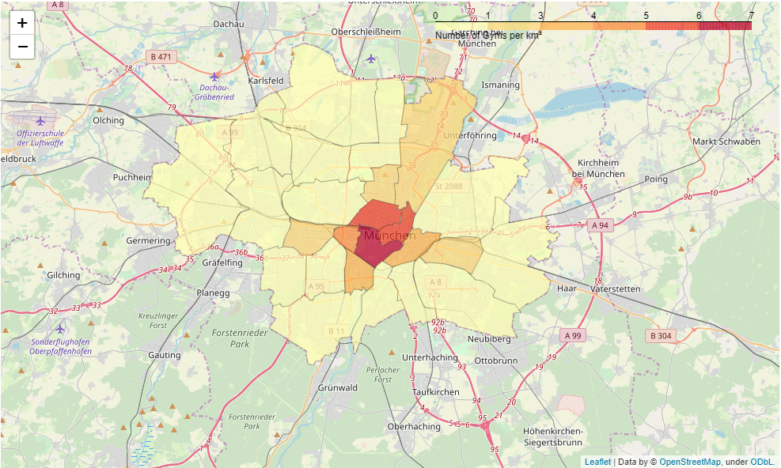
Projektanalyse – Folie 3
Methodology
Fitness Center Key figures
Gym Density per km²

Slide 10
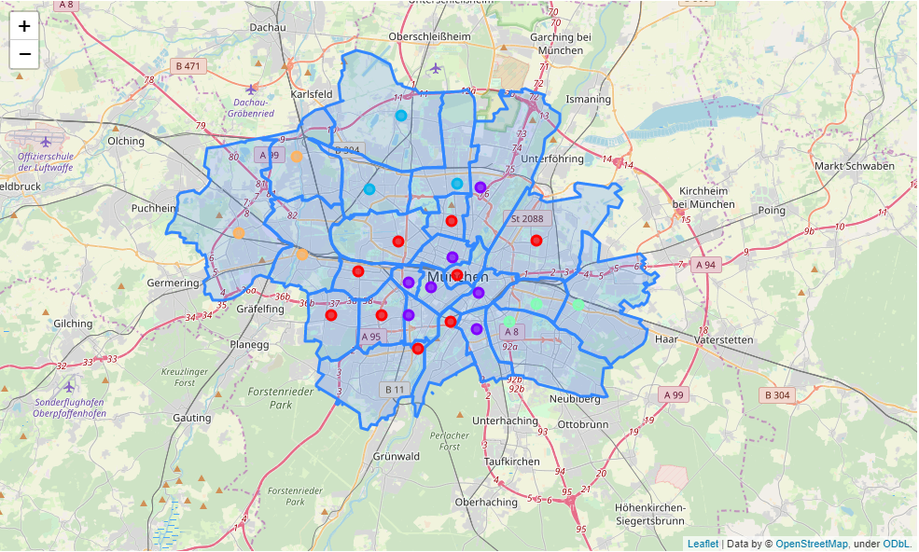
Projektanalyse – Folie 3
Methodology
Clustering
According to the population datasets (e.g. Average age, birthrate, etc.) the Neighborhoods in Munich are clustered into 5 Clusters with similar living conditions.
Neighborhood clusters in Munich

Slide 11
Projektanalyse – Folie 3
Methodology
Cluster - Average
For each cluster an average of the 3 fitness center key figures are calculated
For example: Neighborhoods in Cluster 1 have an average count of 18 gyms
Cluster | avg_gym_count | avg_gyms_per_1000 | avg_gyms_per_km2
0 | 13.555556 | 0.256607 | 1.850335
1 | 18.000000 | 0.337494 | 3.522278
2 | 6.000000 | 0.101572 | 0.477776
3 | 14.333333 | 0.201312 | 1.169052
4 | 4.333333 | 0.077949 | 0.233952

Slide 12
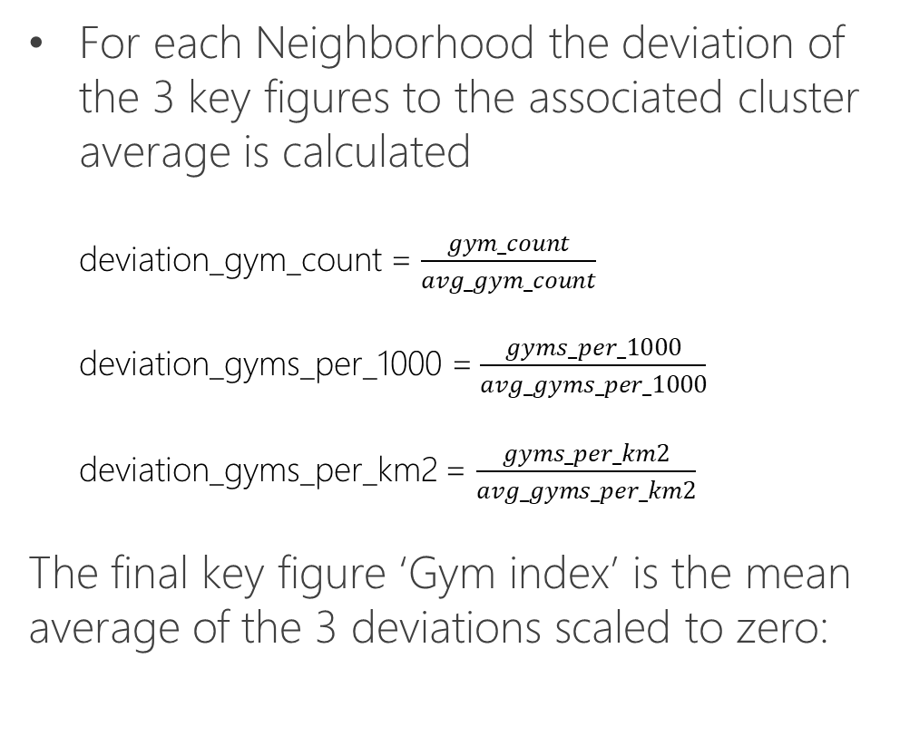

Projektanalyse – Folie 3
Methodology
Calculation of the Gym Index
For each Neighborhood the deviation of the 3 key figures to the associated cluster average is calculated deviation_gym_count = $\frac{gym_count}{avg_gym_count}$ deviation_gyms_per_1000 = $\frac{gyms_per_1000}{avg_gyms_per_1000}$ deviation_gyms_per_km2 = $\frac{gyms_per_km2}{avg_gyms_per_km2}$
The final key figure ‘Gym index’ is the mean average of the 3 deviations scaled to zero:
gym_index = $\left(\frac{deviation_gym_count +deviation_gyms_per_1000+deviation_gyms_per_km2}{3}\right)−1$

Slide 13
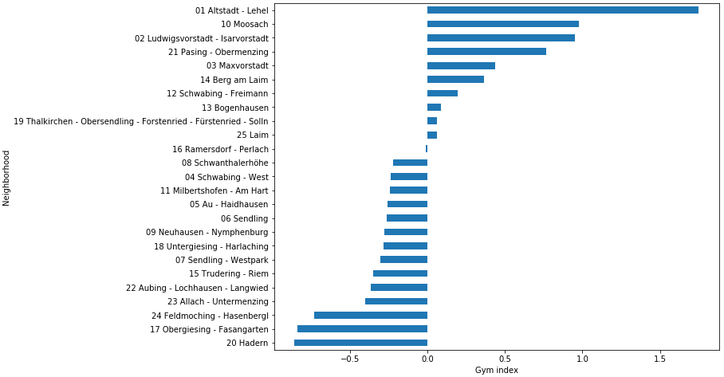
Projektanalyse – Folie 3
Methodology
Gym Index
A gym index of zero means no deviation to the cluster average. Values less than zero indicate Neighborhoods with less gym density than average and values greater zero indicate Neighborhoods with higher gym density than average. So negative values showing high market potentials for fitness center.

Slide 14
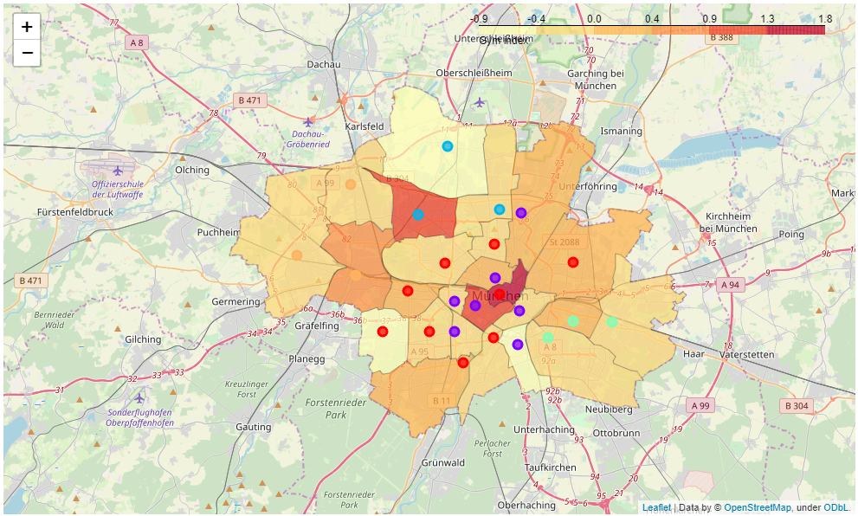
Projektanalyse – Folie 3
Results
Gym Index
shown as a choropleth map

Slide 15
Projektanalyse – Folie 3
Results
Top 10
Neighborhood | Popu-lation | Pop. per_km2 | Gym count | Women gym | Gyms per1000 | Gyms per km2 | Women % | Gym index | Distance (km)
20 Hadern | 49626 | 5380 | 2 | 0 | 0.0403 | 0.2173 | 52.5 | -0.8593 | 7.2
17 Obergiesing - Fasangarten | 53937 | 9429 | 3 | 0 | 0.0556 | 0.5263 | 49.7 | -0.8397 | 3.0
24 Feldmoching - Hasenbergl | 60933 | 2106 | 2 | 0 | 0.0328 | 0.0692 | 49.6 | -0.7328 | 9.3
23 Allach - Untermenzing | 32677 | 2115 | 2 | 0 | 0.0612 | 0.1290 | 49.8 | -0.4005 | 10.9
22 Aubing - Lochhausen - Langwied | 46385 | 1362 | 3 | 0 | 0.0646 | 0.0879 | 50.1 | -0.3673 | 12.2
15 Trudering - Riem | 72006 | 3207 | 11 | 0 | 0.1527 | 0.4888 | 49.9 | -0.3518 | 6.7
07 Sendling - Westpark | 59386 | 7599 | 10 | 0 | 0.1683 | 1.2820 | 51.3 | -0.3044 | 4.6
18 Untergiesing - Harlaching | 52600 | 6529 | 10 | 0 | 0.1901 | 1.2345 | 51.2 | -0.2847 | 2.4
09 Neuhausen - Nymphenburg | 98520 | 7629 | 14 | 1 | 0.1421 | 1.0852 | 51.8 | -0.2756 | 3.7
06 Sendling | 40682 | 10329 | 11 | 2 | 0.2703 | 2.8205 | 49.9 | -0.2623 | 3.4
Neighborhoods with high market potential
(gym index)

Slide 16
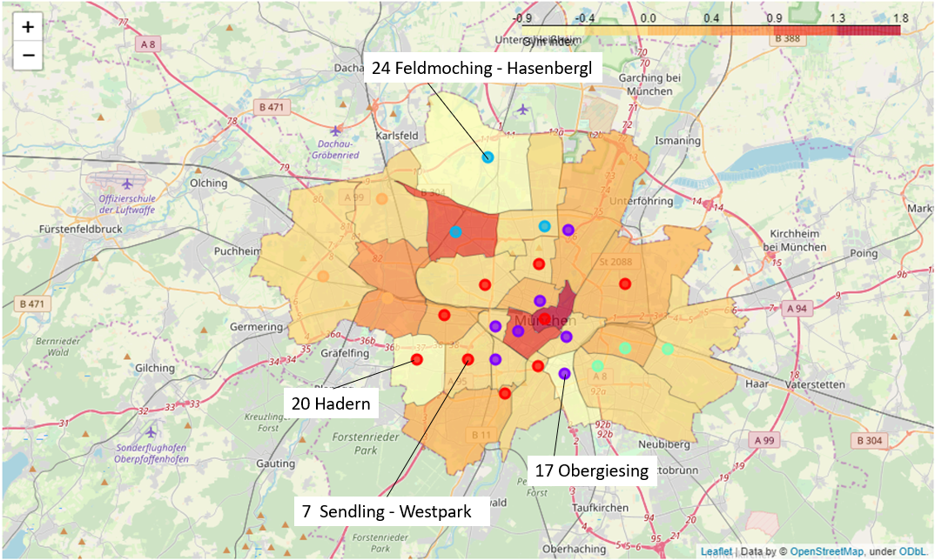
Projektanalyse – Folie 3
Discussion
District 20 Hadern has the highest market potential according to the gym index. Neighborhood 17 Obergiesing - Fasangarten has almost the same market potential but is only about 3 kilometers away from city center what makes this Neighborhood also very interesting. 7 Sendling - Westpark is the first inner city Neighborhood with a good market potential and would be also a choice for a new opening under such restrictions.

Slide 17
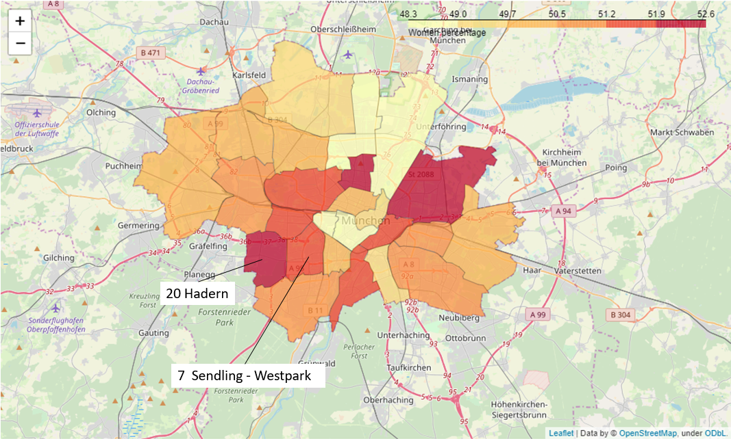
Projektanalyse – Folie 3
Discussion
When we have a look at women percentage from the OpenData we can see that Neighborhood 20 Hadern has almost the highest share of women but no Women only Fitness Center. 07 Sendling-Westpark has also a quite high women percentage and also no women only gym. Both neighborhoods have a high market potential and would be very interesting for a women only fitness center opening.

Slide 18
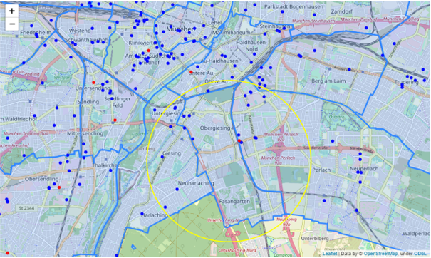
Projektanalyse – Folie 3
Conclusion
The calculated gym index together with the OpenData about the Munich Population gives a very good basis for decision making of the stakeholders. Within the selected Neighborhood a detailed further analysis on possible exact locations on street level is necessary. Therefore the location map of all gyms in Munich from the FOURSQUARE search is a good starting point to find a building for the opening of a new fitness center.
If we would concentrate on 17 Obergiesing - Fasangarten the map for decision making would look like this:

